Slide 1
UNIVERSITY MODEL

Slide 2
ABSTRACT
The purpose of this project is to measure the quality of education delivered by the university by developing a performance evaluating system that evaluates the success of students from different colleges in the university and rates the courses offered by each department in the available colleges and mentions the performance measure of the departments in the university while also reporting the placement statistics of the listed colleges with the graphical analysis of each of the alumni. Further, keeping the track of students performance, faculty’s performance based on the feedback given by the students and also the course and department ranking based on the placement statistics will help the administrators take the decision which will eventually help to improve the quality of education.

Slide 3
OBJECTIVE
The main objective of this model is to develop a University Course Ranking and Feedback System.
To create interface which displays all the informations of current students and their courses
To display all the available courses in each department and also their performance which will help in the ranking of each department
To display the performance of the alumni in their professional career and also the overall rating given by the alumni to a particular course which will help in enhancing the course structure in a department
To provide feedback on faculty which is represented as faculty rating

Slide 4
INTRODUCTION
We have designed a system which displays the performance rate of the alumni from each college and the ratings given by them to the courses taken by them which helped in their success. Our system also shows the faculty details and the courses related to them along with the rating given by the students to each faculty. Our graphical analysis displays charts to answer the question “Students from which college have performed better in their job role?”. All these details will help the university decide which courses are useful and the ones needed to upgrade and ones that need to be removed.

Slide 5
SCOPE
The project when completed will provide the study of the practical applicability of the courses offered by the university and the faculty who taught it

Slide 6
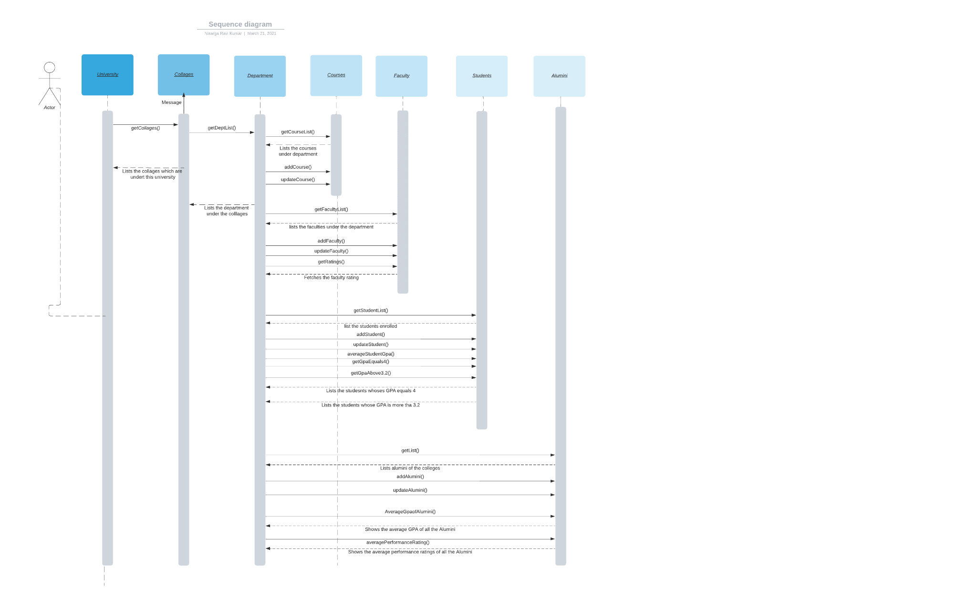
SEQUENCE DIAGRAM

Slide 7
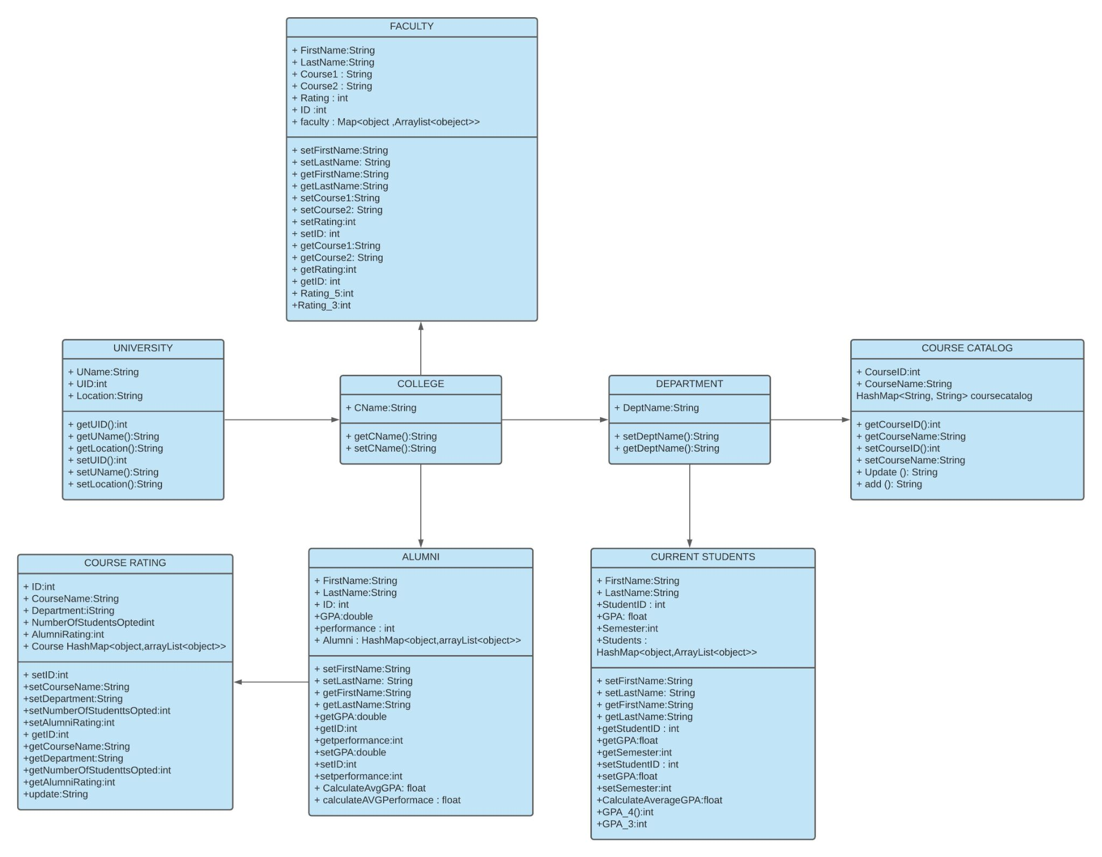
UML DIAGRAM

Slide 8
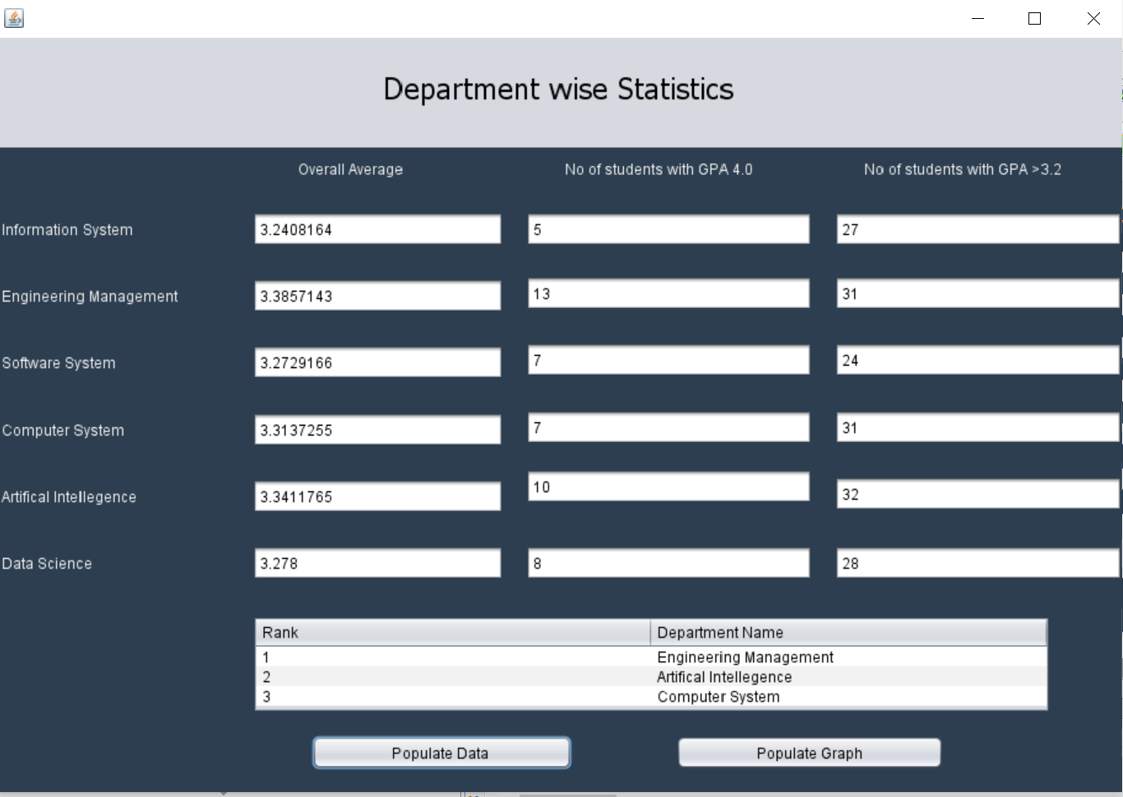

Slide 9
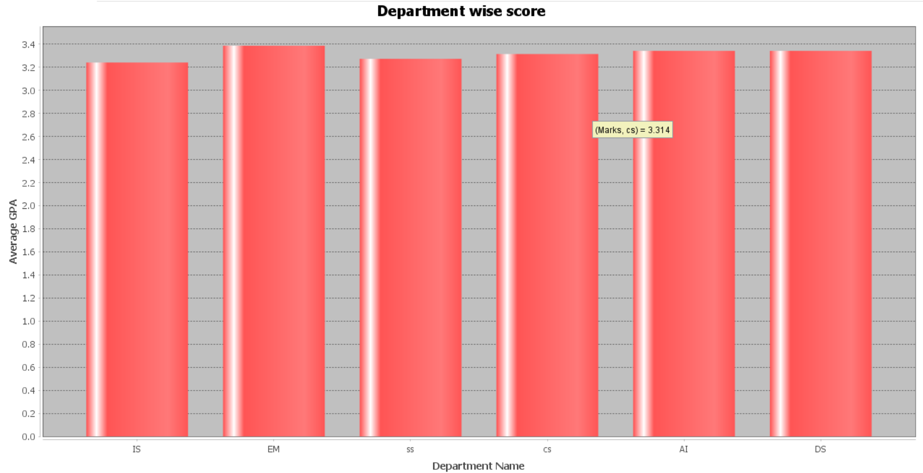

Slide 10
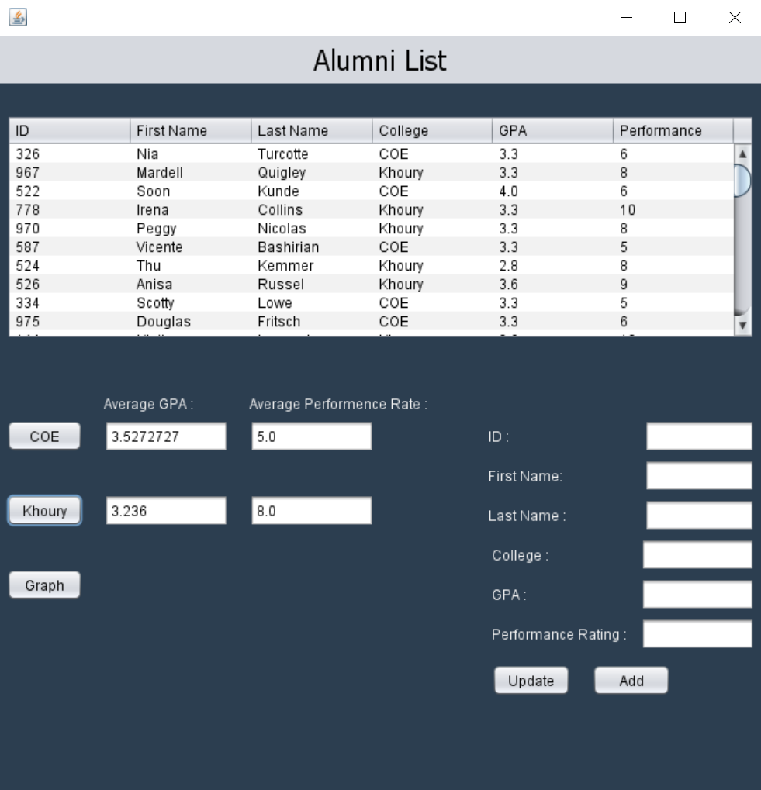

Slide 11
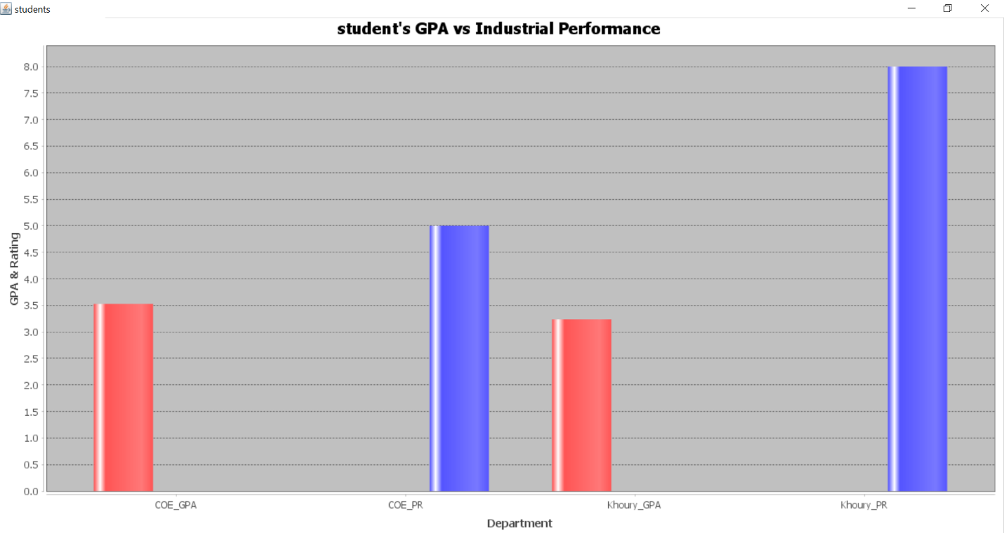

Slide 12
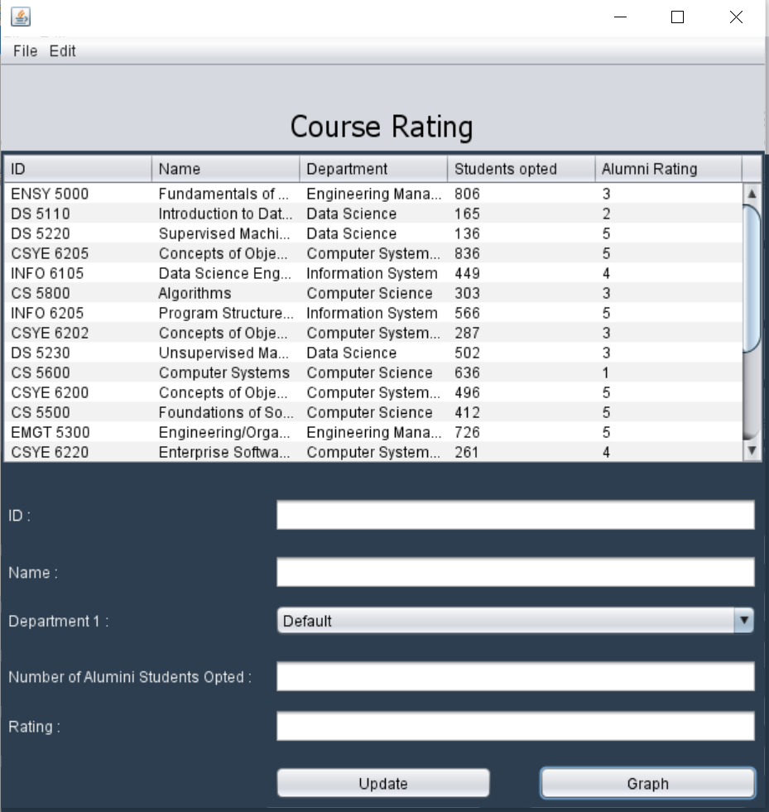

Slide 13
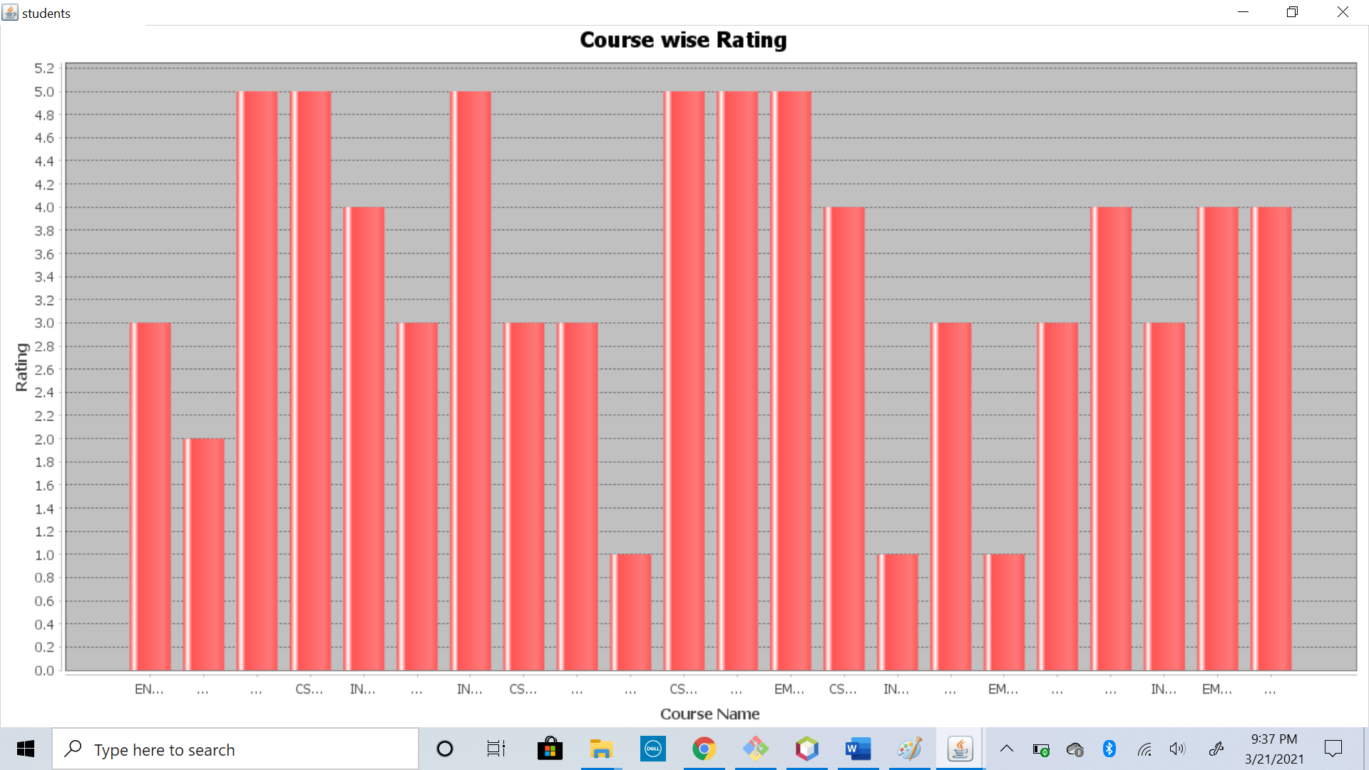

Slide 14
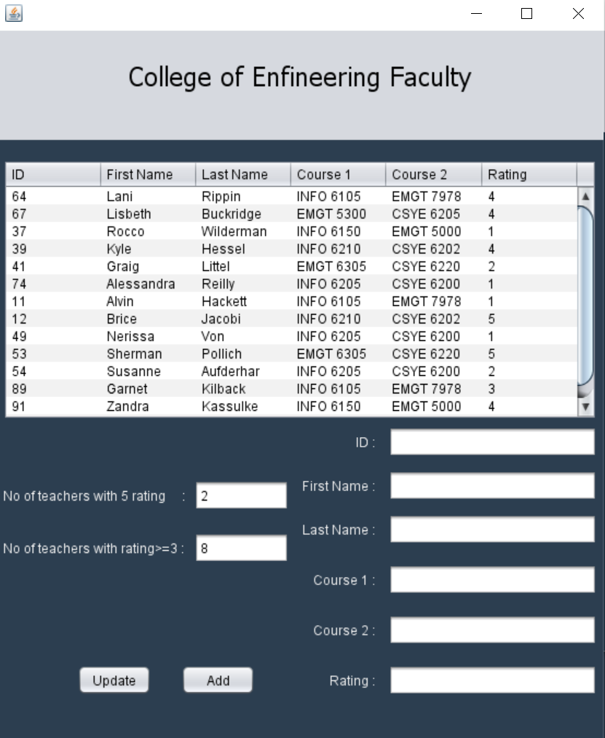

Slide 15
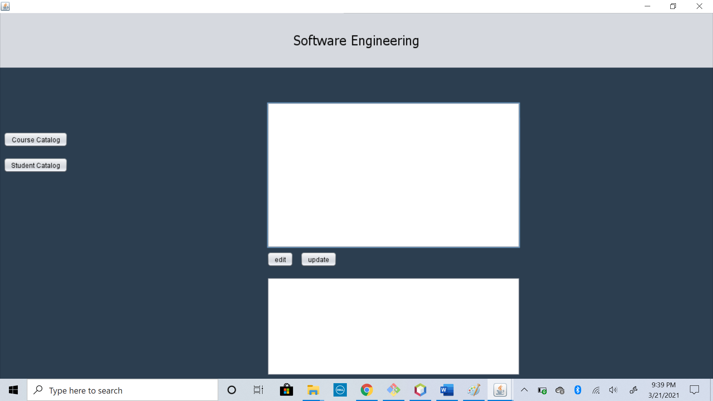

Slide 16
